Slide 1


Class Monitor Pitch Deck
Whatsapp Chatbot Pitch
Kitlong Wong 🤩
Yao Chen 😎
Shjie Huang 😄
Monitor your class with Class Monitor!
Yuxin Chen 😊
Xianrui He 🤓
Attend class in a SMART way 🤩🤓

Slide 2




Problem Statement
Introduction
Teacher 👩‍🏫
Teacher
1. Challenging to monitor individual student needs and provide personalized instruction and feedback.
2. Difficulty in selecting suitable and engaging personalized out-of-class materials for each student.
3. Hard to accurately measure and report comprehensive student learning progress and abilities.
Parent 👨‍👩‍👦
Student 👨‍🎓
Teacher
Teacher
1. Limited communication with parents regarding students' learning goals, achievements, and challenges.
2. Inadequate parental involvement and support in the learning process.
3. Absence of parental feedback on teacher satisfaction and class expectations.
1. Limited chances for students to ask questions or seek clarification during or after class.
2. Students' reluctance to participate in class activities due to fear of making mistakes or judgment.
3. Out-of-class supplementary materials that are dull or difficult.
Lack of regular and effective communication with parents about their children's learning goals, achievements, and challenges.
• Lack of parental involvement and support in their children's learning process and outcomes.
• Lack of feedback from parents on their satisfaction and expectations of the teacher and the class.
• Limited or no opportunities to ask questions or clarify doubts during or after class.
• Shy or reluctant to speak up or participate in class activities due to fear of making mistakes or being judged.
• Out-of-class supplementary materials are boring or too difficult.
Write your message

Slide 3
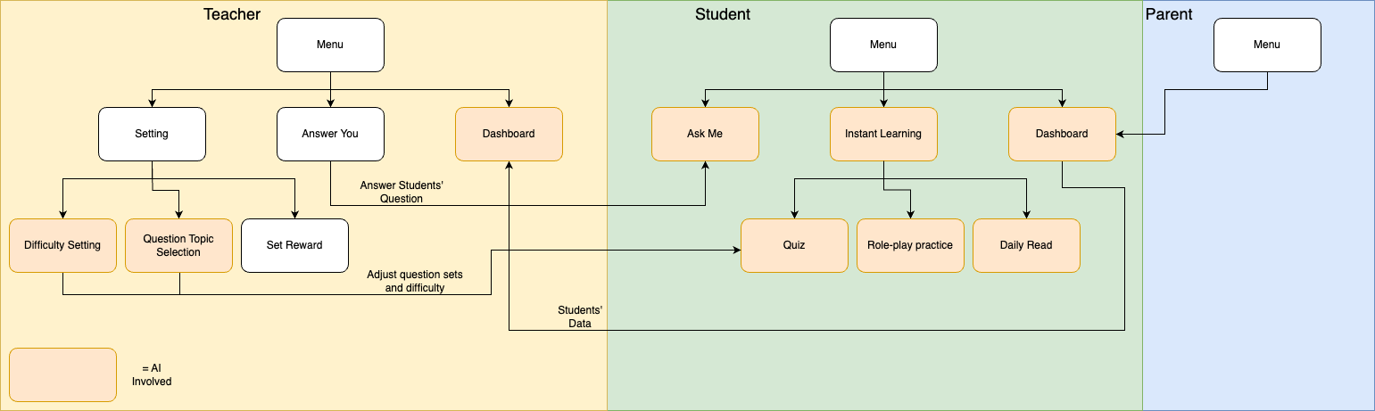
Product Overview
Ask Me 💬
An AI-powered Chatbot that answers students' questions. If the answer is not satisfied, it will be passed to the teacher for further assistance.
Clear Dashboard 📊
A transparent and comprehensive visualization of student learning progress.
Instant Learning 🎓
Provide personalize learning materials for language skills, system and culture.
3 account types with different functions:

Slide 4
Unique Selling Point
Flexible & User-friendly 😊
Based on WhatsApp for seamless accessibility and ease of use
Cost-effective solution for learning
Learn and teach anywhere, anytime
Achieve scalability with a highly adaptable Framework
AI-Powered Personalization 🤖💡
Customized difficulty and content based on students’ goal, interest and ability
AI-assisted quiz and question preparation
Crystal Clear Learning Progress 📈
Tracking improvement and Identifying strengths and weaknesses
Personalized advice from AI, teachers and parents

Slide 5
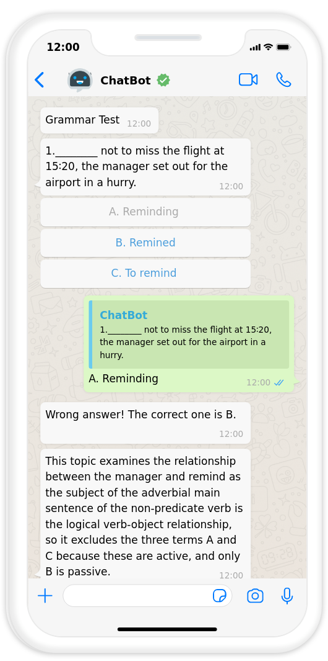
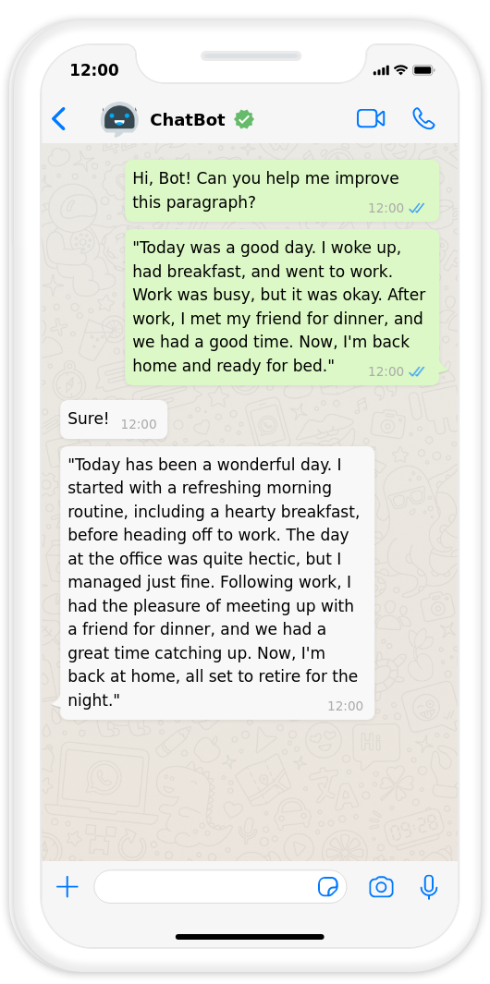
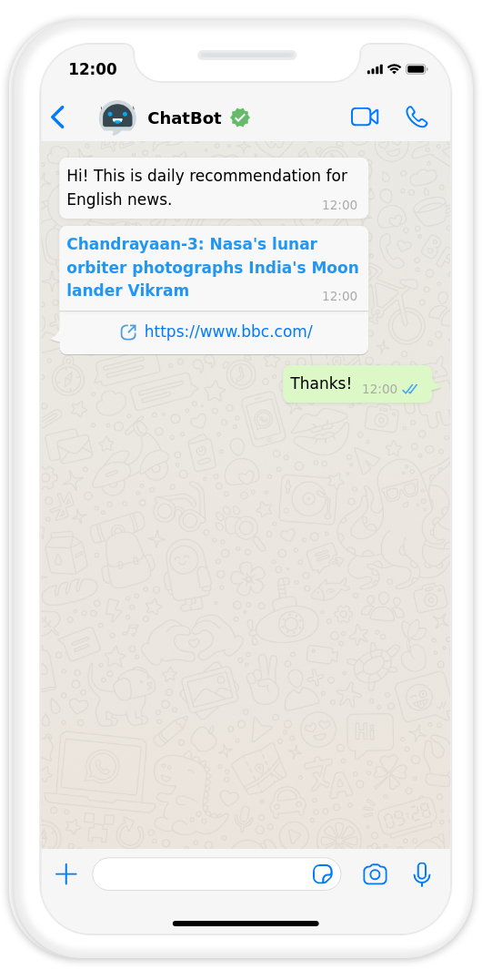
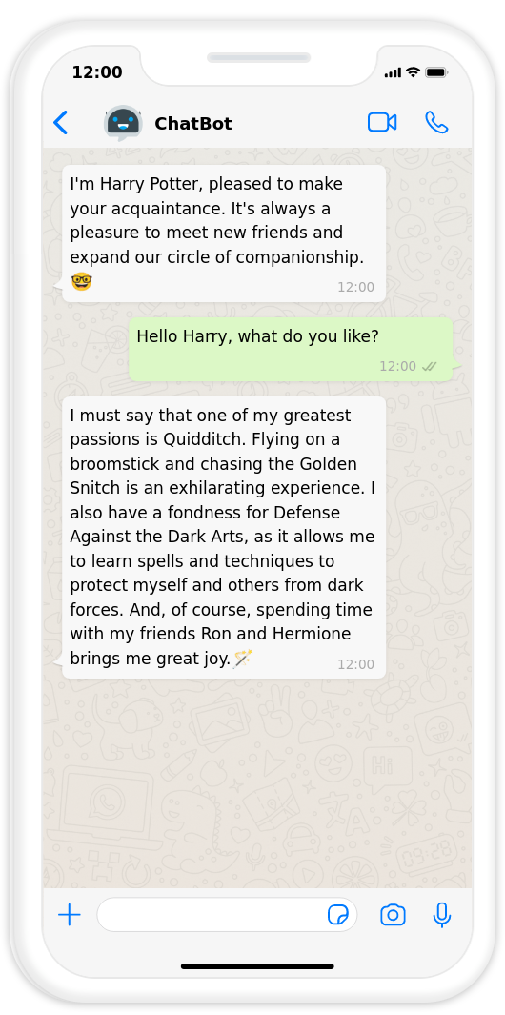
Feature 1: Instant Learning
Quiz 🧠
Quiz
Writing Improve✍️
Daily Read
Role Play 🎭
Quiz
Daily Read 📖
multiple-choice, fill-in-the-blank, matching, and word formation
Difficulty and content based on students’ past performace
Chatbot helps modify students’ writing, give advices and score
Personalized recommendations for Articles, News, and Videos
Short question to check students’ understanding
The Chatbot is designed to adopt various themes and engage in lively communication with students
Voice and text messaging

Slide 6


Feature 2: Ask Me
Quick Answer ✅
Answers
The chatbot responds to students' inquiries and provides them with accurate answers.
Efficient Management💼
Learning
Answers
Questions
The chatbot assists teachers in swiftly comprehending students' situations, eliminating the need for repetitive inquiries.
Unsolved Problems Summarization
AI Evolution 🤖
The chatbot learns from teachers' responses and incorporates that knowledge to offer improved solutions in future interactions.

Slide 7
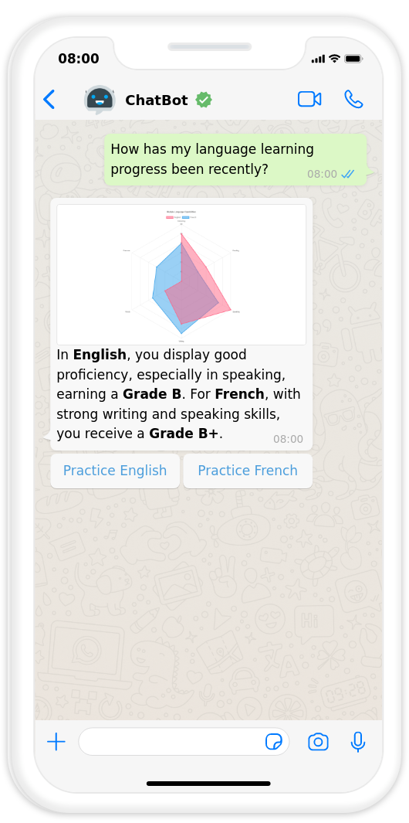
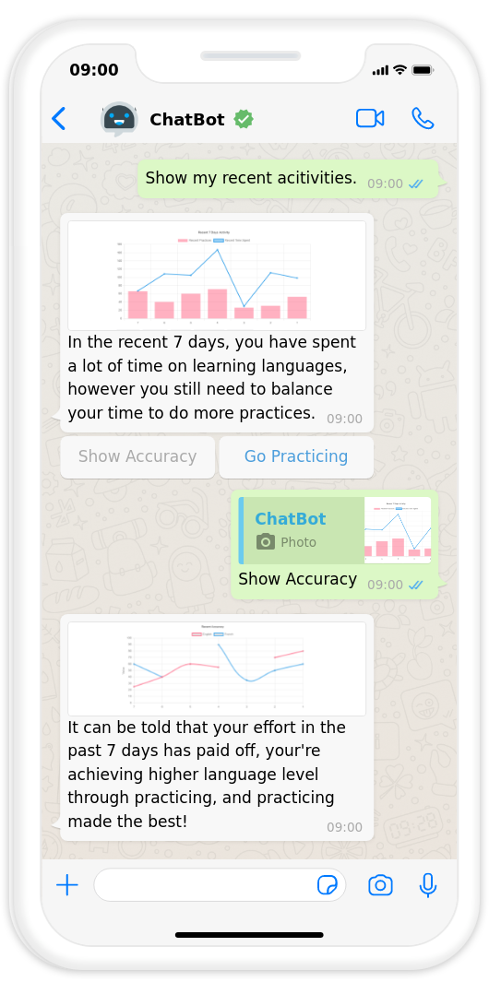
Feature 3: Students’ Dashboard
Performance Summary 📝
Detail Analysis 🔍
Quick review of students’ overall learning performance and activeness
A comprehensive review of various language skills and system
Insightful feedback and analysis generated by AI
Drill-down analysis: compare students’ performance over time, compare with classmates, progress towards personal goals, etc
Clear graphs are utilized to present the analysis and comparisons in a visually understandable manner.

Slide 8
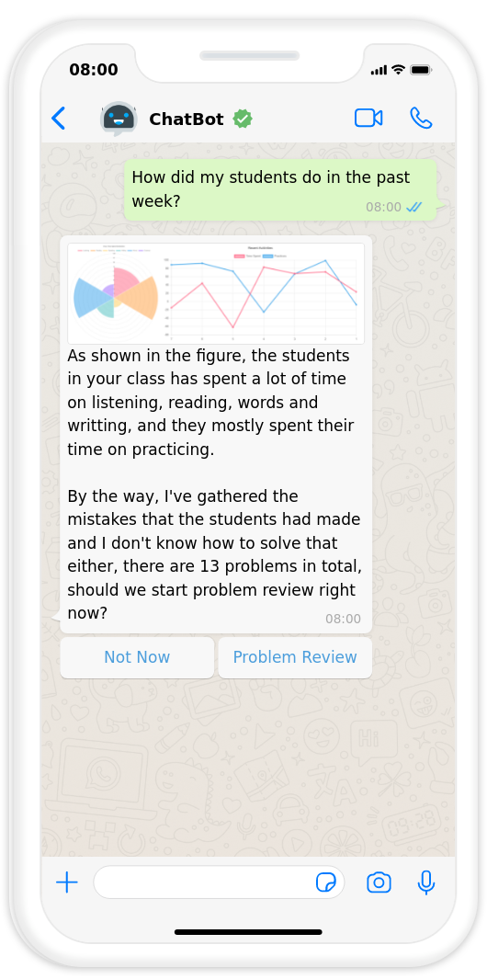
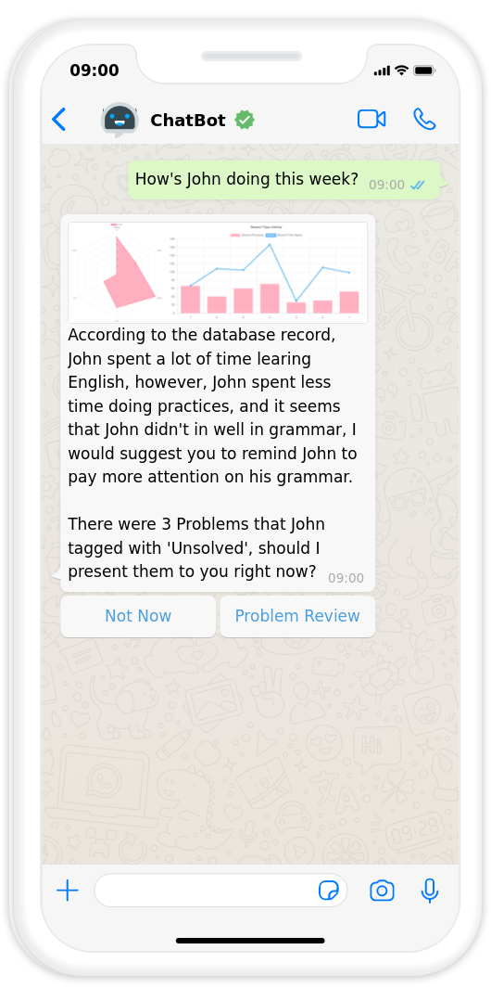
Feature 4: Teachers’ Dashboard
Class Summary 📊
Detail Analysis 💡
Quick review of class’ overall learning performance and activeness
A comprehensive review of various language skills and system
Students’ questions and parents’ feedback are analyzed and conslidated by AI
Drill-down analysis of a specific student
Clear graphs are utilized to present the analysis and comparisons in a visually understandable manner.

Slide 9
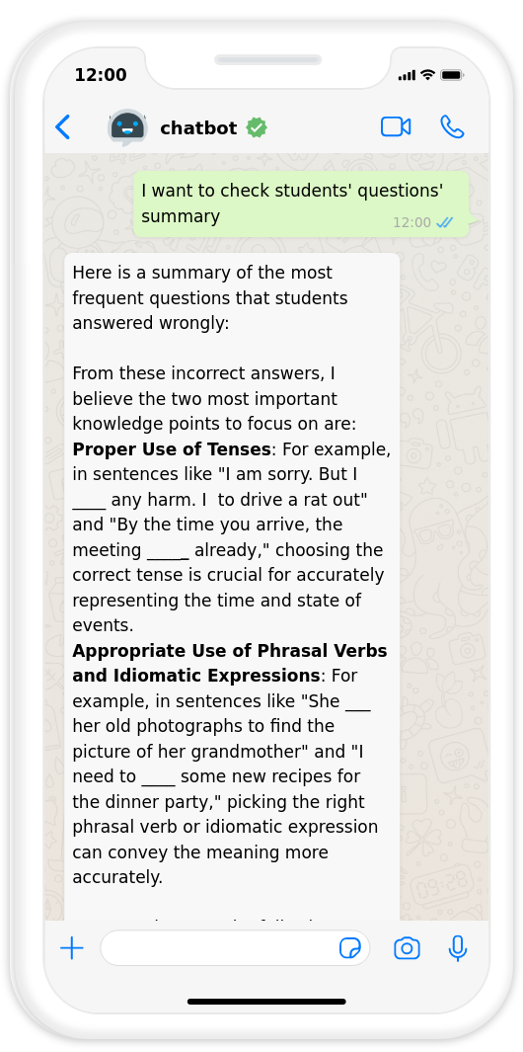
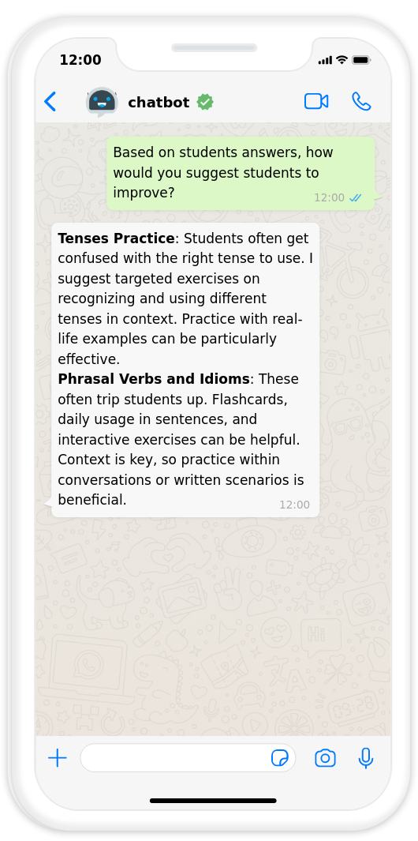
Feature 5: Smart Customization
Customized Reply 📩
Content Adjustment📚
Teachers have the capability to respond to questions and feedback from both students and parents
The AI system learns from the comments and responses provided by teachers, enabling it to improve its future responses based on the acquired knowledge
Teachers have the ability to modify the difficulty level and learning content for the entire class or individual students
The AI provides helpful suggestions to assist teachers in making appropriate adjustments based on their inputs and requirements.

Slide 10
Tech Stack & Advantages
01
02
Intelligent Assistant
Evolutionary Assistant
AI-powered assessments, dynamic quiz generation, and common query summarization
Harnessing the ower of vector store for self-optimizing intelligence and adaptive learning. Never repeating the same mistake.
03
04
Multi-Scenario Knowledge Base
Personalized Study Material
using vector store to achieve intelligent function dispatch and ensuring accuracy on relevant topics while avoiding off-topic/sensitive content
using reinforcement learning & recommandation system to tailoring learning resources to Individual needs & abilities

